Slide 1

First Responder Hazmat Awareness Level Training
UNIT 1 - “Preparation”
Notes:
1
1

Slide 2
Unit Objectives
Define Hazardous Materials
Identify the role of the Awareness Level First Responder
Identify the Awareness Level Response Goals
Notes:
2
2

Slide 3
Hazardous Materials
Defined in numerous ways
U.S. Department of Transportation (USDOT)
U.S. Environmental Protection Agency (USEPA)
U.S. Occupational Safety and Health Administration (OSHA)
Simplified Definition
Extremely Hazardous Substances
Notes:
3
3

Slide 4
Hazardous Materials Incidents
“Haz-Mat” incidents are unique incidents. They require specialized protective measures not normally available to first responders AND they demand a different operational approach!
Notes:
4
4

Slide 5
Public Safety “Duty to Act”
Public safety responders have a “Duty to Act”.
Your level of involvement is defined by your employer’s Emergency Response Plan (ERP).
The actions you are expected to take should be in Standard Operating Procedure format.
NEVER exceed your level of training and protection!
Notes:
6
6

Slide 6
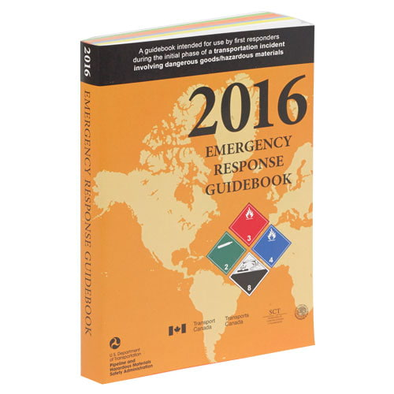
North American Emergency Response Guidebook
Your tool for success.
Purpose:
An aid for identification of the material involved.
Outlines basic initial actions.
Recommends protective action areas.
Serves as an initial incident safety plan.
Notes:
8
8

Slide 7
Five Levels of Training
First Responder Awareness Level
First Responder Operational Level
Hazardous Materials Technician
Hazardous Materials Specialist
Hazardous Materials Incident Commander
Notes:
11
11

Slide 8
Operational Modes
Awareness and Operational level responders take DEFENSIVE actions.
Technicians and Specialists take OFFENSIVE actions.
The Incident Commander coordinates the response and is ultimately responsible for safety.
Notes:
12
12

Slide 9
First Responder Awareness Level Training
Unit 2 - “Hazard Identification”
Notes:
1

Slide 10
Unit 2 - Hazard Identification
Unit Objectives:
- Identify the six clues to the presence of hazardous materials.
- Identify the various hazard classes of hazardous materials.
- Describe ways in which you can determine the specific identity of a hazardous material.
Notes:
2

Slide 11
Clue #1-Occupancy and Location
Specific occupancy or general area
Fixed facilities
Five modes of hazardous materials transportation
Drug lab considerations
Notes:
2

Slide 12
Clue # 2 - Container Shape and Size
Classifications
Portable, fixed or transportation
Pressure
Non-pressurized, low or high pressure
Vapor Pressure and Storage
The higher the pressure, the greater the potential for catastrophic failure
Notes:
6

Slide 13



Clue # 3 - Placards and Labels
Placards and their limitations
Not always required
The 1000 pound rule
Placards and labels used for transport are based upon DOT Hazard Class
Nine Hazard Classes
Subdivided into divisions
Notes:
7

Slide 14


Hazard Classes
Hazard Class 1 - Explosives
Hazard Class 2- Gases
Notes:
8

Slide 15


Hazard Class 3-
Flammable/Combustible Liquids
Hazard Class 4- Flammable Solids
Notes:
9

Slide 16

Hazard Class 5- Oxidizers and Organic Peroxides
Hazard Class 6- Poisonous and Infectious Substances
Notes:
10

Slide 17
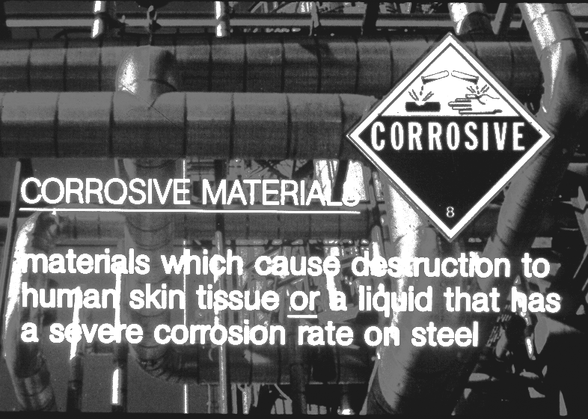

Hazard Class 7- Radioactive Materials
Hazard Class 8- Corrosive Materials
Notes:
13

Slide 18
Hazard Class 9-
Miscellaneous Hazardous Materials
Notes:
16

Slide 19
Clue # 4 - Shipping Papers and Facility Documents
Notes:
18

Slide 20
Material Safety Data Sheets (MSDS)
Required to be maintained by the Federal Hazard Communication Standard and The Florida Right-to-Know Law
Found at fixed facilities
Provides a variety of information
Emergency Response Plans (ERP)
Emergency Action Plans (EAP)
Notes:
19

Slide 21
Clue # 5 - Markings and Colors
Container colors are not always standardized
UN/NA identification numbers
NFPA 704 Diamond
Military markings
Notes:
20

Slide 22
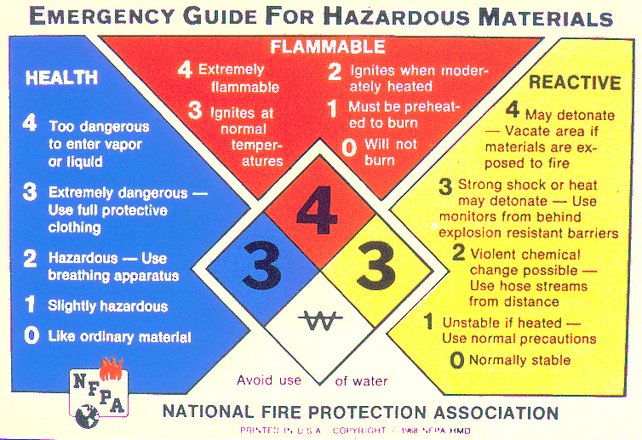
Notes:
21

Slide 23
Clue # 6 - Human Senses
RISK
LEVEL
Low
High
Taste Sound Sight Smell Touch
Notes:
22

Slide 24
Methods of Identification
Once you recognize, try to identify
Location of material name
Shipping papers
MSDSs (fixed facilities)
Facility Pre-Plans
Employees and bystanders
If you cannot safely identify, try to classify the material into a hazard class
Notes:
23

Slide 25
Unit Summary
Goals of recognition and identification
Recognize, Classify, Identify
Six clues to the presence of hazardous materials
Occupancy and location, container shape and size, placards and labels, shipping papers and facility documents, markings and colors, the human senses
There are nine general classes of hazardous materials
Notes:
24

Slide 26
First Responder Awareness Level Training
Unit 3 - “Taking Control”
Notes:
1
1

Slide 27

Objectives
Identify the procedures for initiating your Emergency Response Plan.
Identify the proper procedures for implementing protective action distances.
Take actions necessary to properly isolate the incident.
Notes:
2
2

Slide 28
ERG Book
North American Emergency Response Guidebook
Familiarize yourself
Download App
Notes:
3
3

Slide 29
Steps for Proper Use of the ERG
Recognize & Identify Hazardous Materials
Name
Four digit ID number
Placard description
Look up the guide page number
Take basic protective actions according to the guide page
Initiate isolation and evacuation according to protective action distances
Notes:
4
4

Slide 30

Basic Protective Actions
Your approach
Your main objectives
Isolate
Protect by preventing contamination
Initiate your Emergency Response Plan (Notify)
Notes:
5
5

Slide 31
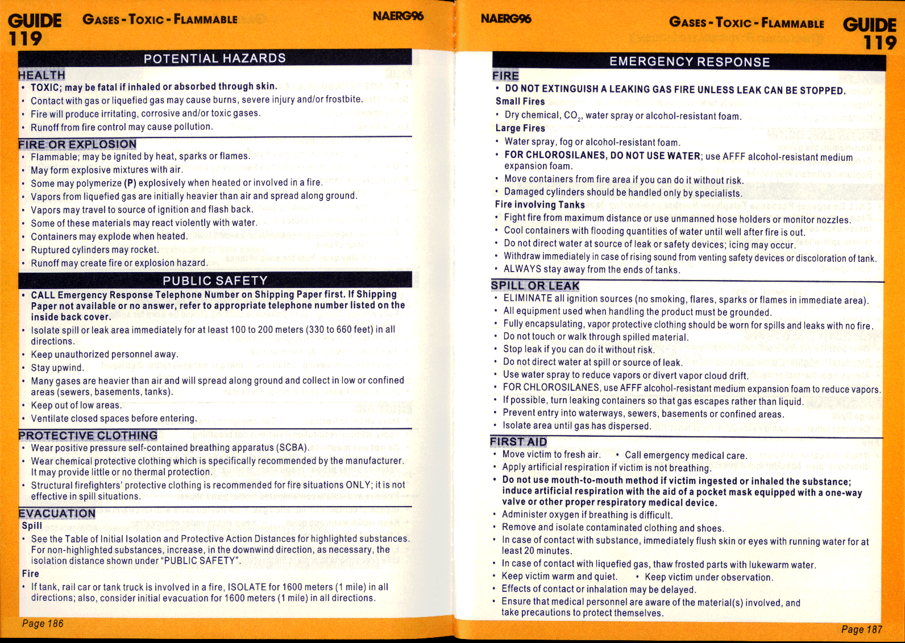
Proper Guide Page Use
Notes:
6
6

Slide 32
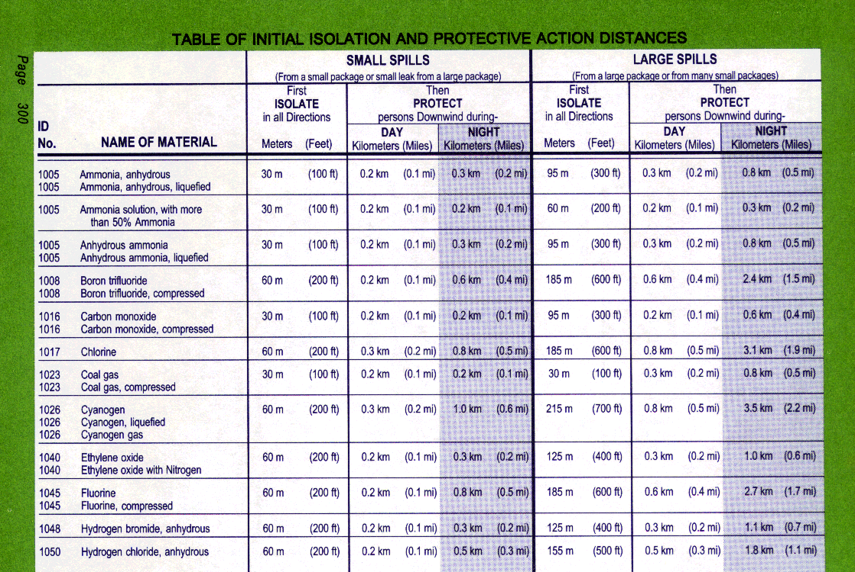
Table of Protective Action Distances
Notes:
7
7

Slide 33
Protective Action Options
Shelter in-place
Short duration incidents
Greater hazard to attempt to move
Impractical to evacuate
Evacuation
Potential for massive fire or explosion
Long duration incidents
Notes:
8
8

Slide 34
Emergency Response Information
Firefighting
Definition of “Haz-Mat Fire”
Defensive Vs. Offensive
Role of the awareness responder
Spill / Leak Control
Not an awareness level role
First Aid
Remember to prevent secondary contamination
Notes:
9
9

Slide 35
Summary
ERG provides guidelines
You can find a guide page by:
Name, ID number or placard comparison
Basic instructions - page 1
Two indexes
Orange guide pages
Green protective action pages
Notes:
10
10

Slide 36
THE END
Thank you and stay safe!!

